Slide 1

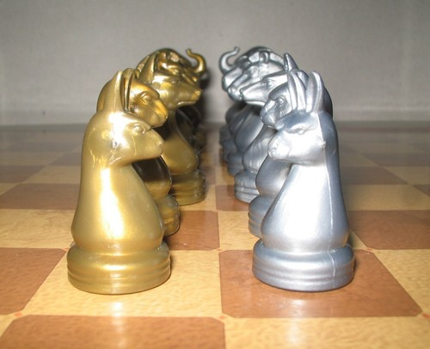
Fast and furious Game Playing : MonteCarlo drift
Students:
Prateek Bhatnagar Baptiste Bignon Mikaïl Demirdelen Gabriel Prevosto Dan Seeruttun--Marie Benoît Viguier
Supervisors:
Nikolaos Parlavantzas Christian Raymond
Year 2014-2015

Slide 2
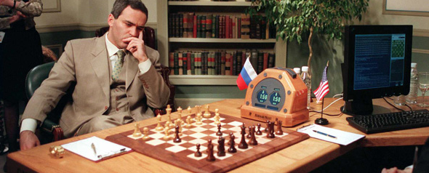
Introduction
ARIMAA

Slide 3

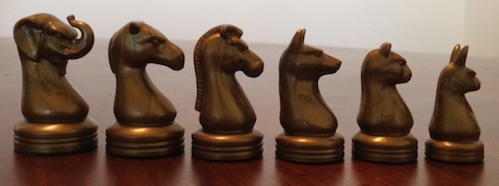
Project Presentation
Goal of the project :
Generate an AI for an unsolved 2 players board game
Arimaa

Slide 4
Project Presentation
Which algorithm to use ?
Game
Average number of moves
AI used
Chess
Game of Go
Arimaa
35
250
20 000
position evaluation
MCTS
pos. eval. & MCTS
Monte Carlo Tree Search : cutting edge of the AI research algorithm.

Slide 5


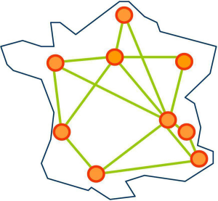
Project Presentation
Project goals :
Use a calculus power using
CPU parallelization or
GPU parallelization
Develop the solution on
1 Computer
Computers on our Computer Science department
Grid'5000, IRISA
Notes:
Here is the presentation of our project. Our purpose will be to build an Artificial Intelligence for a 2 players strategy board game, but not entirely solved like checkers, or Dames in French, but not to much studied like Chess.
For our Artificial Intelligence, we will use the MCTS algorithm, a very knowed algorithm able to calculate one of the best moves to play. The MCTS algorithm don't guess all moves possible, it just select the best moves and develop them, to see where they leads. Then, it computes statistics to make it possible to select a move.
Then we will apply the algorithm to game, beginning by simple one like TicTacToe, or Morpion, and Connect 4, or Puissance 4. Then, we will apply to the non solved game Arimaa, similar to Chess when we see the board, but with so much possibilities it is impossible to solve it with a computer.
We will choose away to compute the tree of moves, between different types of parallelization.
To improve the power of our computation, we will run it using CPU parallelization of our computers, then GPU parallelization on our graphical card of our computers, and Finally in Grid'5000, The cluster of computers handled by the IRISA.

Slide 6
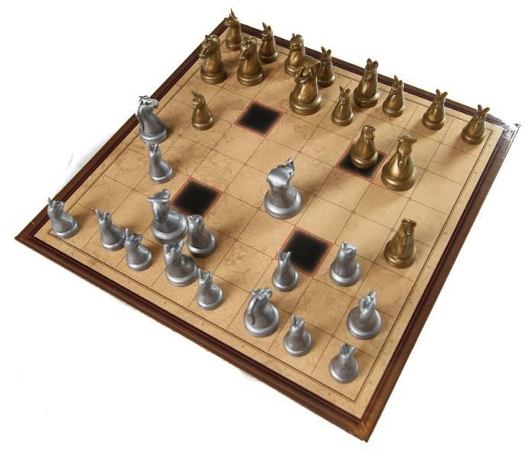
Contents
Introduction
Arimaa presentation
MCTS algorithm
Parallelization methods
General architecture
Specifications
Conclusion

Slide 7
Arimaa : the Game
Plays on a chess board
Follows simple rules
Difficult to play for artificial intelligence
Unlike for chess, no algorithm running on a modest personal computer can best the human champions

Slide 8
The rules: Basic rules
Each player starts off with 16 pieces, as follows :
Each player disposes of 4 moves per turn
A win is achieved by having a rabbit reaching the opposite side of the board

Slide 9
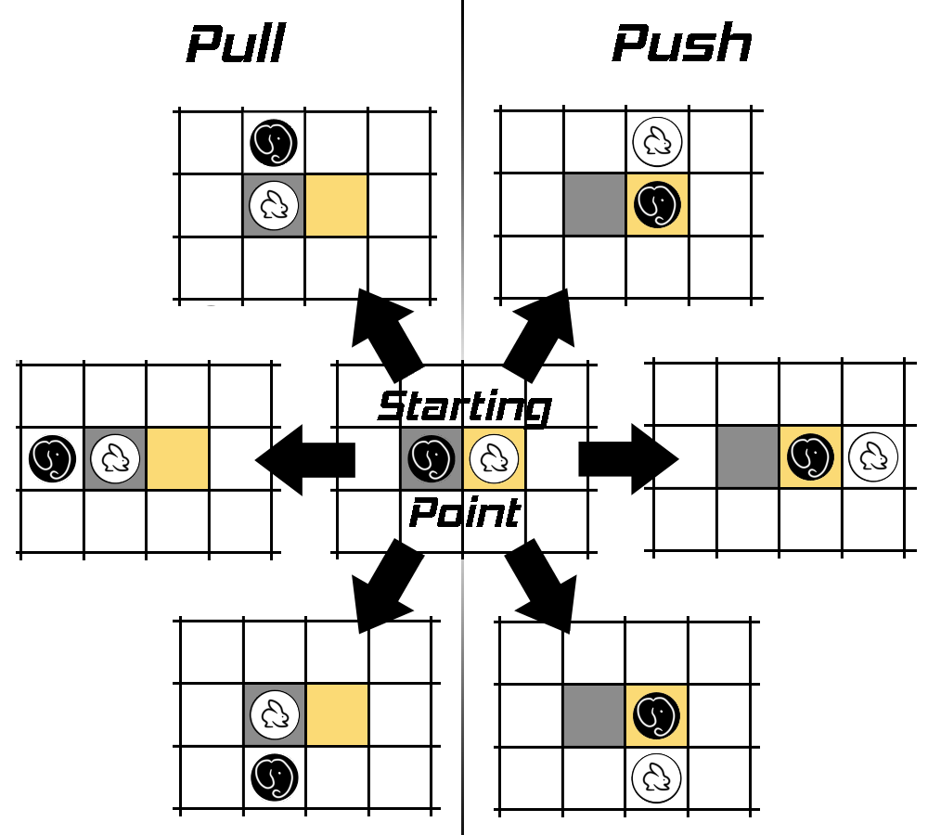
The rules: Displacement
Any piece can push or pull an adjacent enemy piece, if said piece is weaker.

Slide 10
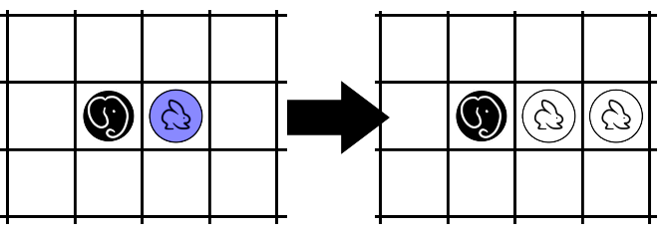
The rules: Freezing
A piece standing next to a stronger enemy piece cannot move unless there is an ally piece beside it.

Slide 11
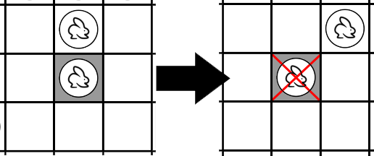
The rules: Traps
Each piece standing on a trap dies, unless there is an ally piece beside it.

Slide 12

The rules
That's it !
Simple isn't it ?
But not for computers.

Slide 13
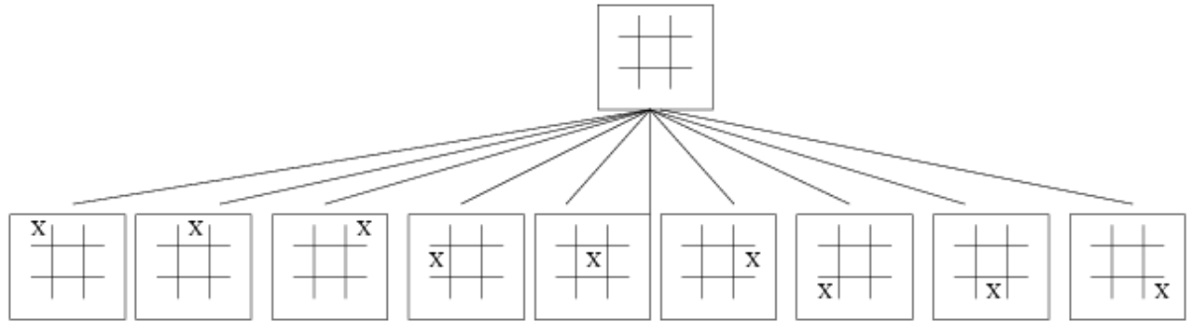
Search tree
In a search tree : - each node is a position.
- each edge is a move.

Slide 14
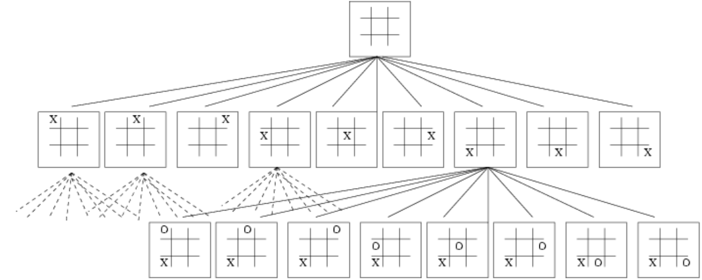
Search tree
In a search tree : - each node is a position.
- each edge is a move.

Slide 15
Which algorithm to use ?
Branching factor : average number of moves given a position
Game
Average number of moves
A.I. used
Chess
Game of Go
Arimaa
35
250
20 000
position evaluation
MCTS
pos. eval. & MCTS
Monte Carlo Tree Search : cutting edge of the AI research algorithm.

Slide 16
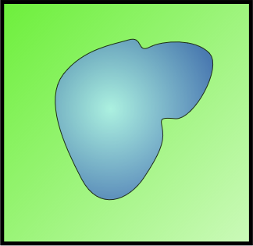
Monte Carlo Method
Area of the field : 1km x 1km = 1km²
Area of the Lake : unknown
Area Lake
Area Field
Theorical probability of falling into the lake :
1km

Slide 17
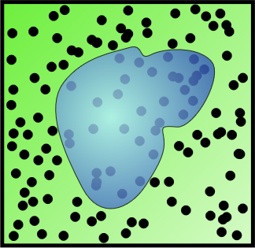
Monte Carlo Method
Area of the field : 1km x 1km = 1km²
Area of the Lake : unknown
300 of 1000 randoms shots fell into the Lake : Probability to fall in the lake : 300/1000 = 30%
Area Lake
Area Field
Theorical probability of falling into the lake :
1km
Area Lake
Area Field
≈ 30%
Area Lake≈ 0,3 km²

Slide 18
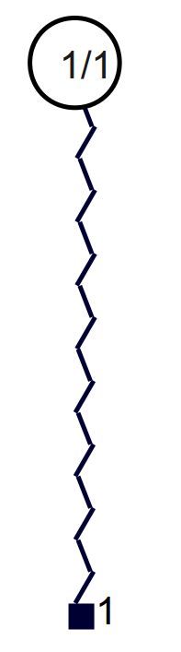
MCTS algorithm
Build a tree with all possible solutions but a small depth.
Upon reaching a leaf, play random moves.
Compute the results (win or loss) to get the odds of outcomes.

Slide 19
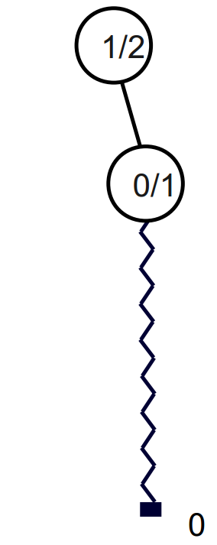
MCTS algorithm
Build a tree with all possible solutions but a small depth.
Upon reaching a leaf, play random moves.
Compute the results (win or loss) to get the odds of outcomes.

Slide 20
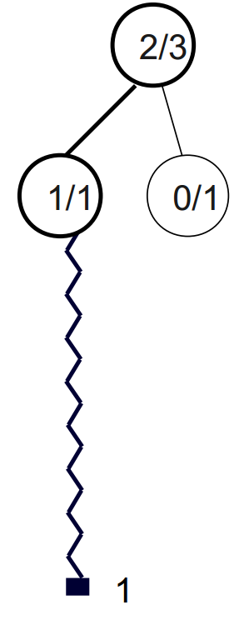
MCTS algorithm
Build a tree with all possible solutions but a small depth.
Upon reaching a leaf, play random moves.
Compute the results (win or loss) to get the odds of outcomes.

Slide 21
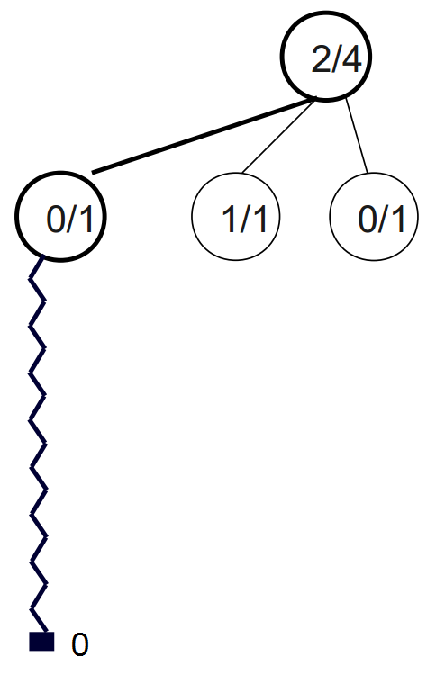
MCTS algorithm
Build a tree with all possible solutions but a small depth.
Upon reaching a leaf, play random moves.
Compute the results (win or loss) to get the odds of outcomes.

Slide 22
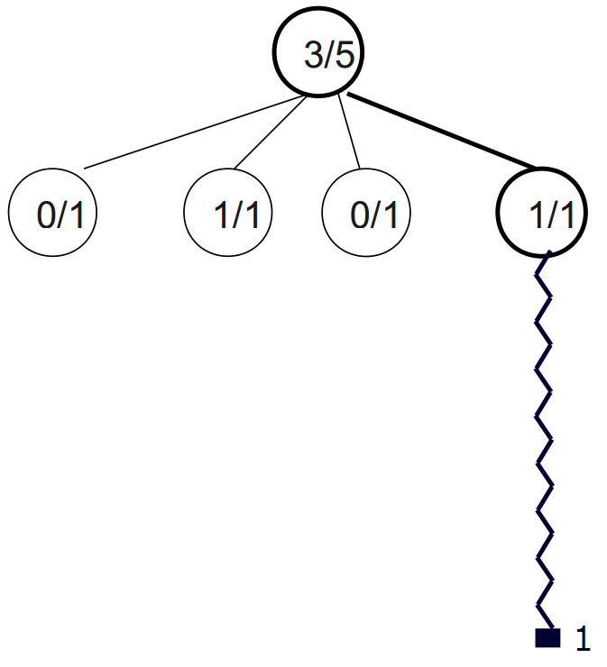
MCTS algorithm

Slide 23
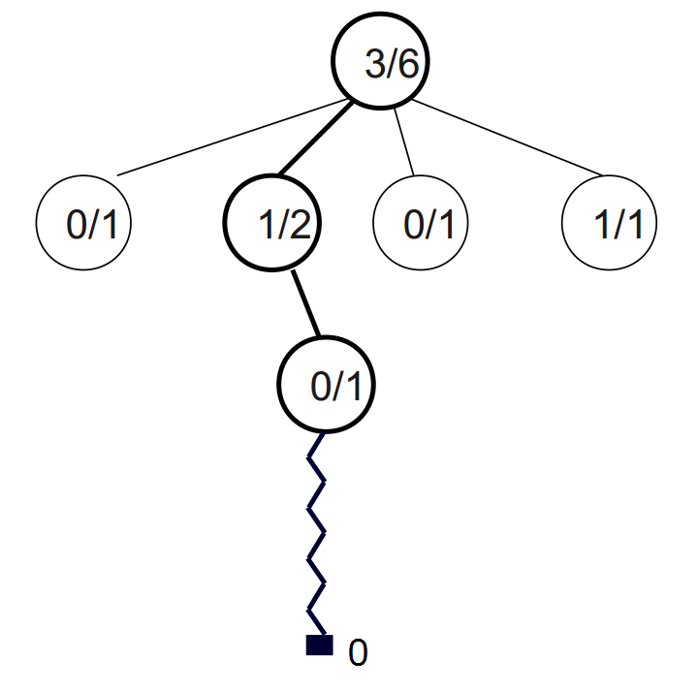
MCTS algorithm

Slide 24
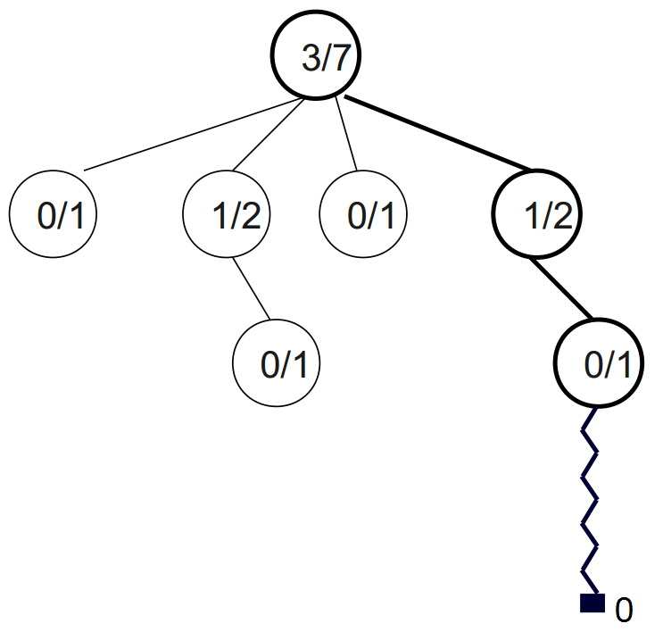
MCTS algorithm

Slide 25
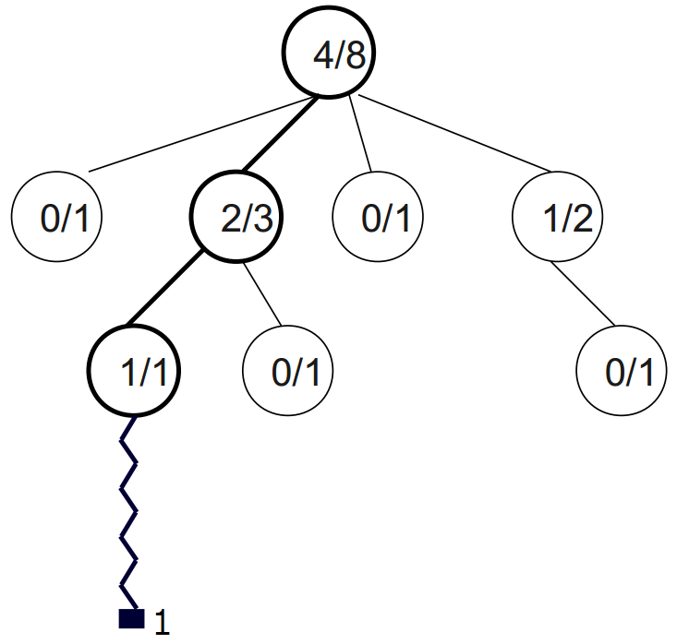
MCTS algorithm

Slide 26
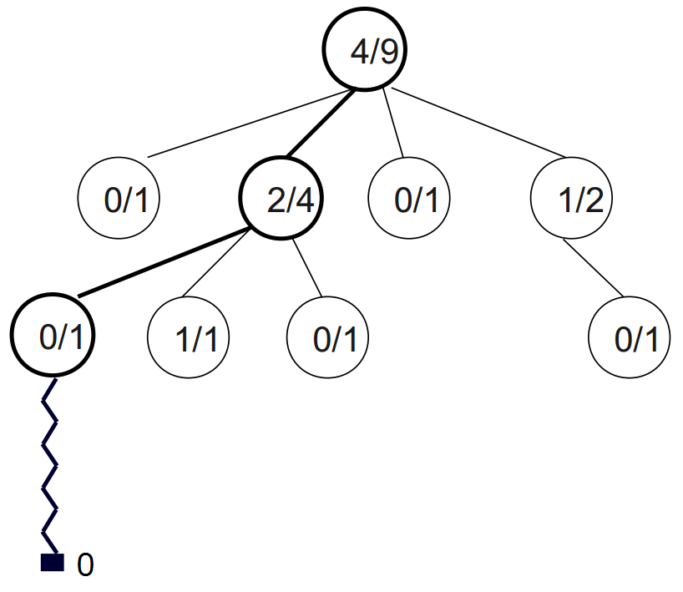
MCTS algorithm

Slide 27
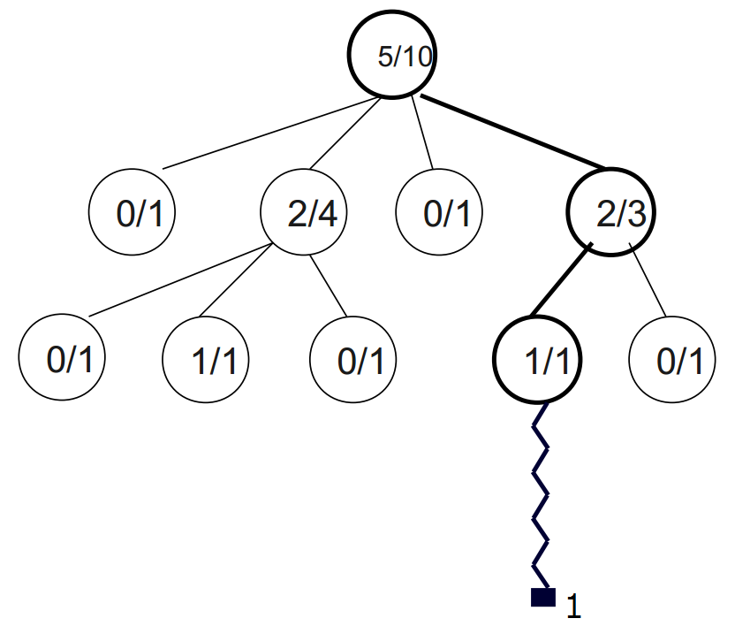
MCTS algorithm

Slide 28
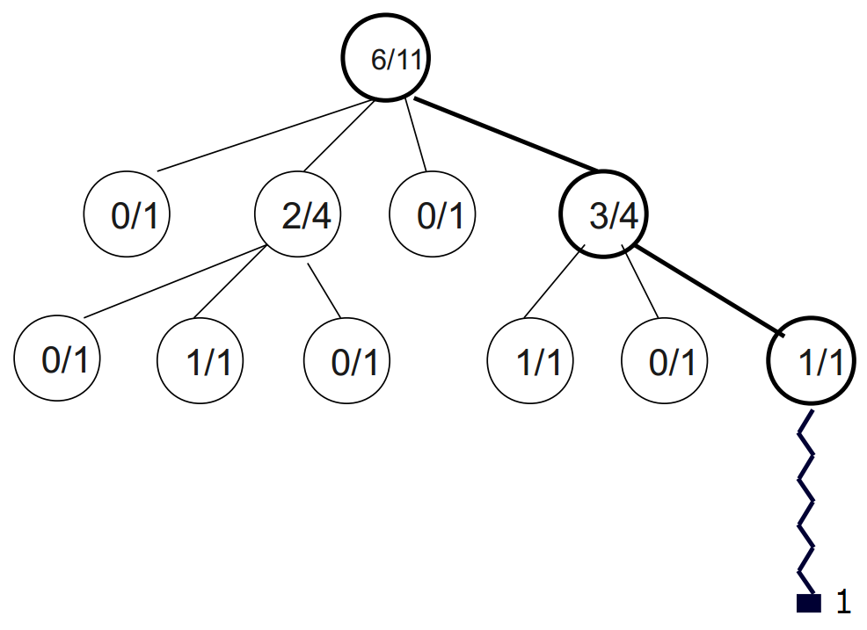
MCTS algorithm

Slide 29
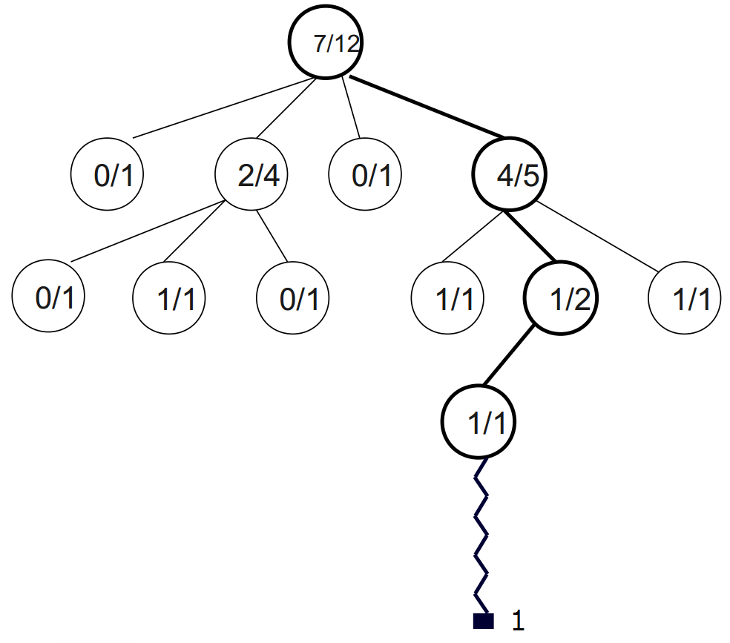
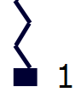
MCTS algorithm
Chose the move with highest winrate : 4/5

Slide 30
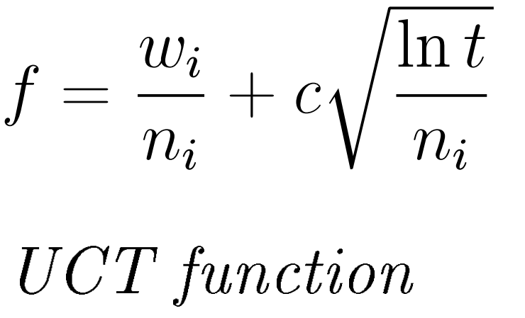
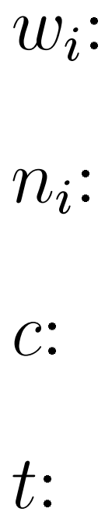
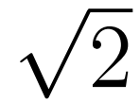
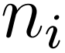
Node selection: UCT Function
UCT : Upper Confidence bound 1 applied to Trees
th
Number of wins of the i node
th
Number of visits of the i node
exploration parameter ( )
Number of visits of the parent node (sum of all )

Slide 31
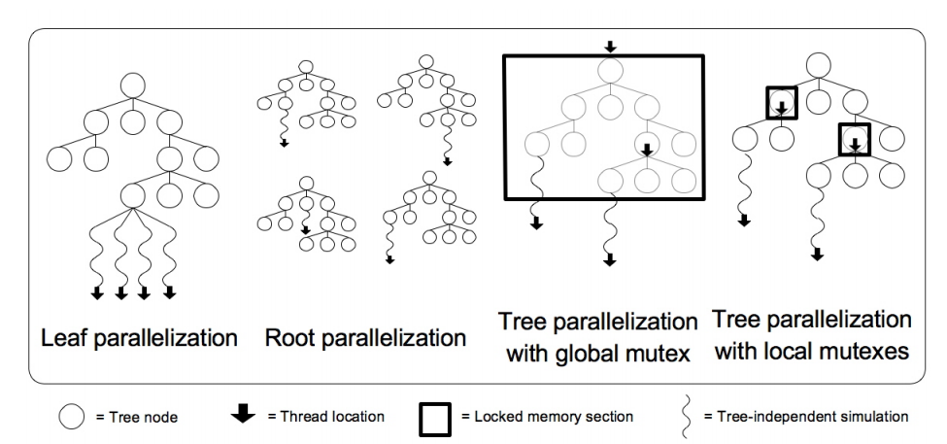
Parallelization methods
Three principal methods :
Chosen solution :
Root-Root

Slide 32
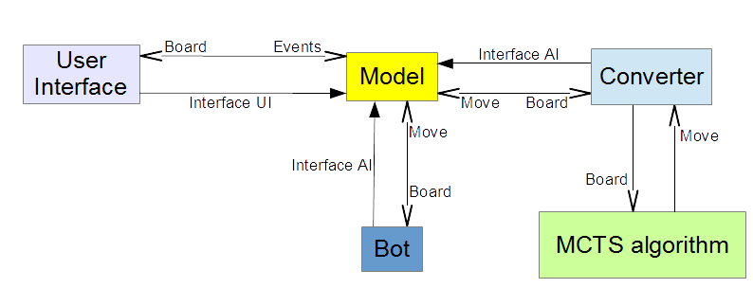
General Architecture
General view module
5 modules:
User Interface
Model
Converter
MCTS algorithm
And possibly a Bot
Notes:
In this part, we are going to study the General Architecture.
Here is the general architecture diagram. We can see the 5 modules interacting with each other.
The User Interface interacts with the environment generating events handled by the model. This module interact with the Artificial Intelligence.
In our project, it will be the MCTS algorithm, connected together thanks to a converter.
But by implementing a single interface, it will be possible for the model to interact with a bot, an other one Artificial Intelligence created by other people. Then, it will be possible to use a bot from the site Arimaa.com

Slide 33
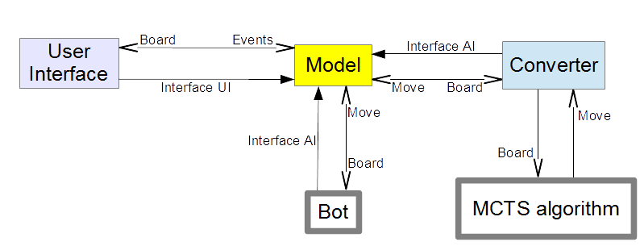
General Architecture
User Interface module
User Interface:
Communication with the player:
menu mode
the game
Send the events to the Model
Notes:
Let's see what is in this modules. The first module is the User Interface, which communicate with the player via the menu mode, and the representation of the game, the board. It will create events, and send them to the Model, to be treated.

Slide 34
General Architecture
Model module
Model:
Handle the game itself
Contains the board
Contains the rules
Call the AI
Notes:
The model will contains the game itself. What is the game here.
It will be the board, the place of all pieces, but the rules as well.
It will be able to call the Artificial Intelligence via the converter.

Slide 35
General Architecture
Converter module
Converter:
Interface
Convert data flux between the Model and the MCTS algorithm
Notes:
The converter module is a simple interface that makes interact the Model and the MCTS algorithm module. It will send the state of the board in this sense, and send the correct move in the other sense.

Slide 36
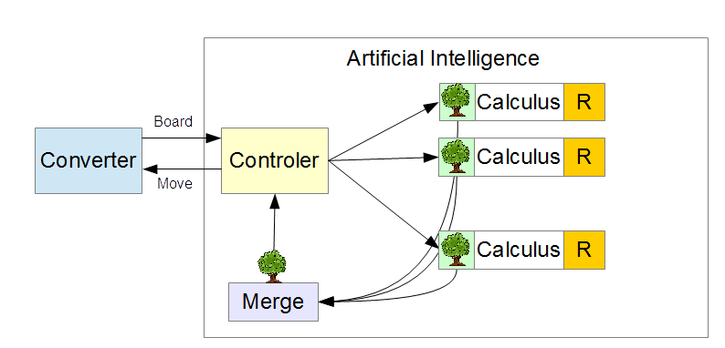
General Architecture
MCTS algorithm module
MCTS algorithm:
Parallelization:
Dispatching of data in
different threads
Calculus of moves
Set of rules
Merging the results
The controler sends the move
Notes:
The MCTS algorithm

Slide 37
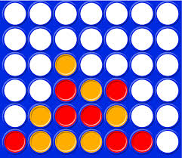
MCTS algorithm's features
Adaptable to several games
allow to play against humans or others AI

Slide 38
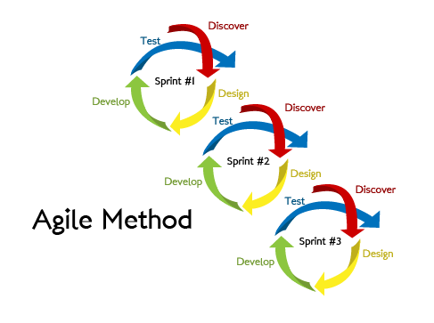
Development Methodologies
Agile Methodology:
Iterative software development
methodology for building and
testing the software incrementally.

Slide 39
Key Areas:
Regular meetings
"To Do" list
Estimation of time and resources
Prioritization of tasks
Development using top to bottom approach
Feedback from the end user or the team
Iteration

Slide 40
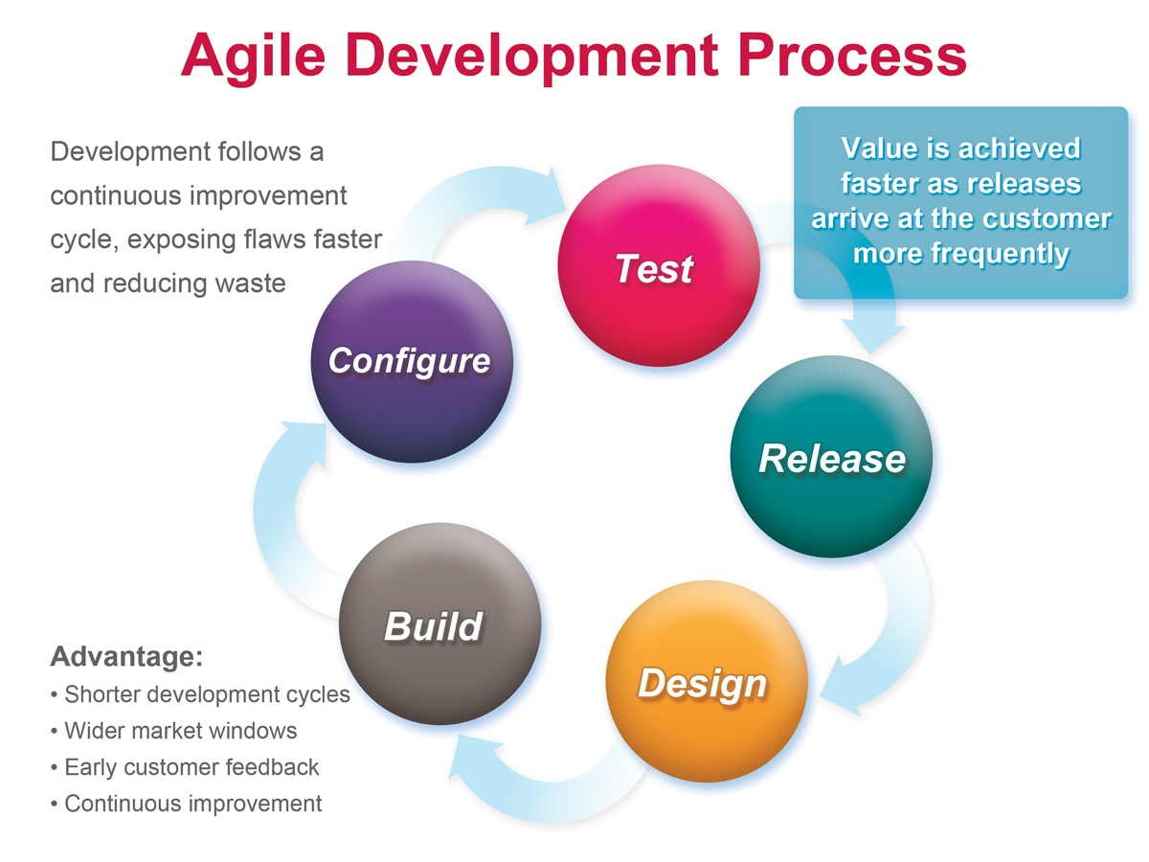

Slide 41
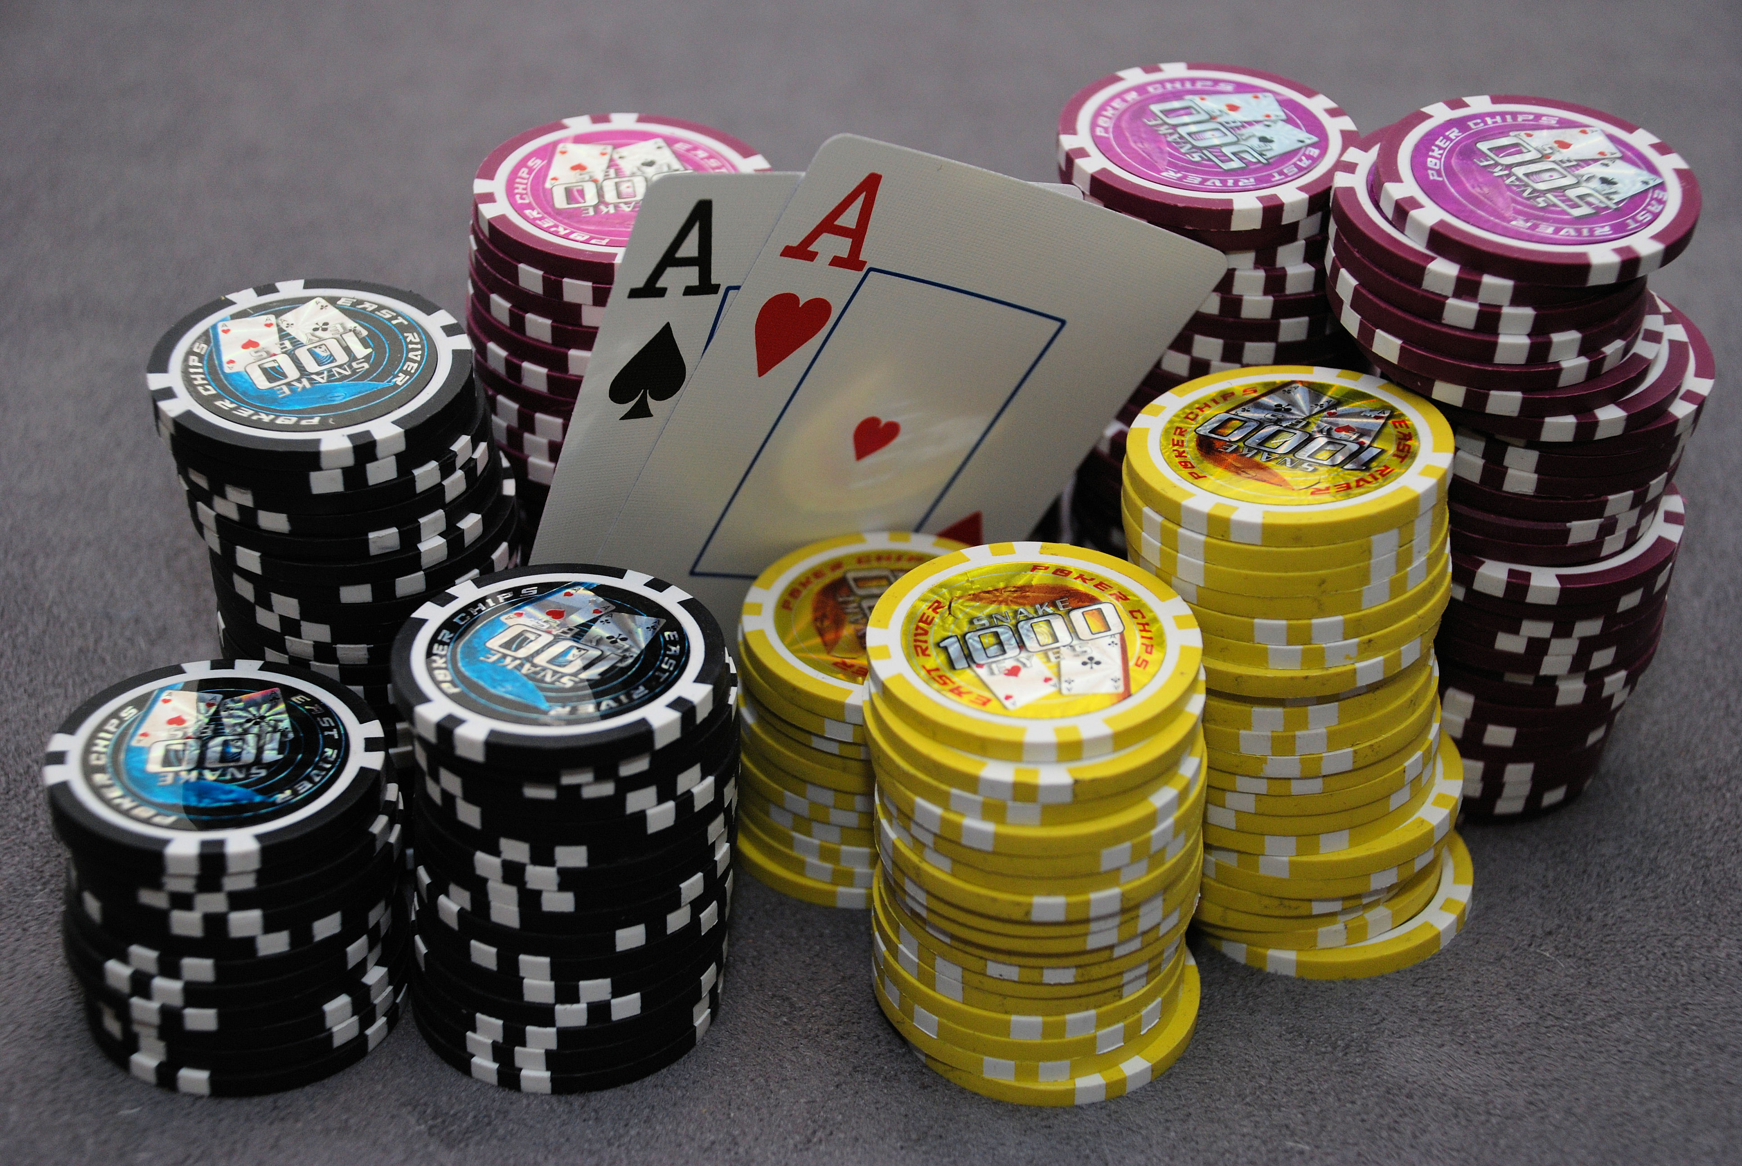
Planning Poker Estimation Technique
Method for workloads
The method:
Guess workloads individually
No influence on the others
The treatment of solutions:
Eliminate singular guesses
Discuss together what will be the workload then

Slide 42


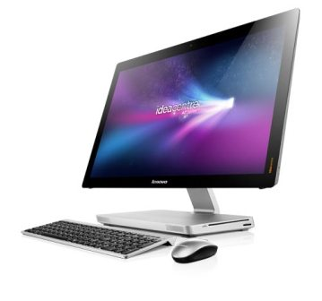
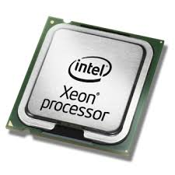
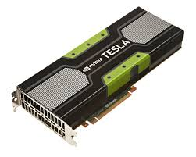
hardware specification
Linux or Windows
Cluster or single Machine
CPU and GPU parallelization

Slide 43
C++ Actor model (CAF)
Actor's possibilities :
send messages to other actors
create new actors
adapt their behavior

Slide 44
Another way to parallelize
Message Passing Interface (MPI)
OpenMP
OpenACC

Slide 45
MPI
Low-level solution
Allows synchronus or asynchronus communication
Uses messages to communicate between the process

Slide 46
OpenMP / OpenACC
Pre-compilation instructions
Simple and quick to implement
Just a little less efficient than other possibilites like CUDA
#pragma omp parallel for for(int i = 0; i < 1 000 000; i++){ ... }
#pragma acc data copy(A), create(Anew) ... #pragma acc kernels for(int i = 0; i < 1 000 000; i++){ ... }

Slide 47
Chronology

Slide 48
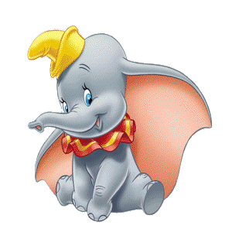
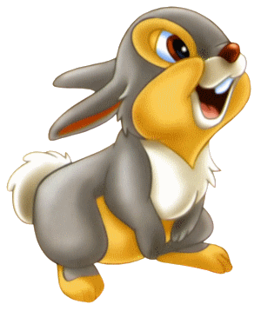
Conclusion
Implementation of an artificial intelligence for Arimaa, based on the Monte Carle Tree Search algorithm
Exploitation of parallelization on a set of clusters of multi-core machines
Creation of a user interface to test the algorithm against humans

